Slide 1
Data and ER Modeling
COMP / IT 420 Lecture 2
February 1st, 2021

Slide 2
Class Outline for Today 2/1/2021
Database assignment and group selection
Homework 1 is out this Wednesday
Due in 2 weeks on February 17th
Data modeling and entity-relationship modeling this week
Entity-relationship modeling and relational databases (SQL beginnings) next week

Slide 3
Attendance Note
If you are not reliably attending the course at this point I will be contacting you about being dropped to allow for wait-list students.
This applies even if you are submitting assignments.

Slide 4
Database Assignment
You will work in teams of 2 for the majority of the semester.
If you have a preferred partner, contact them and let me know that you have chosen each other.
If you do not have a project partner by this Wednesday, you will be assigned one at random.
If you are not present for partner assignment, and do not let me know ahead of time, that may be grounds for a course drop to allow others in.
First project assignment is due at the end of next week on Friday 2/12.

Slide 5
Learning Objectives
Basic building blocks of data-modeling
RDBMS (briefly)
Relational data modeling
How business rules influence DB design
Advanced Data Modeling with Entity-Relationship Diagrams

Slide 6
Data Modeling and Data Models
Model - Abstraction of a real-world object or event
Data models: Simplified representations of complex data structures
Data modeling: Iterative process of creating a specific data model for a problem domain

Slide 7
The Entity Relationship Model
Introduced by Peter Chen in 1976
Represents the conceptual model
Graphically represents entities and relationships

Slide 8
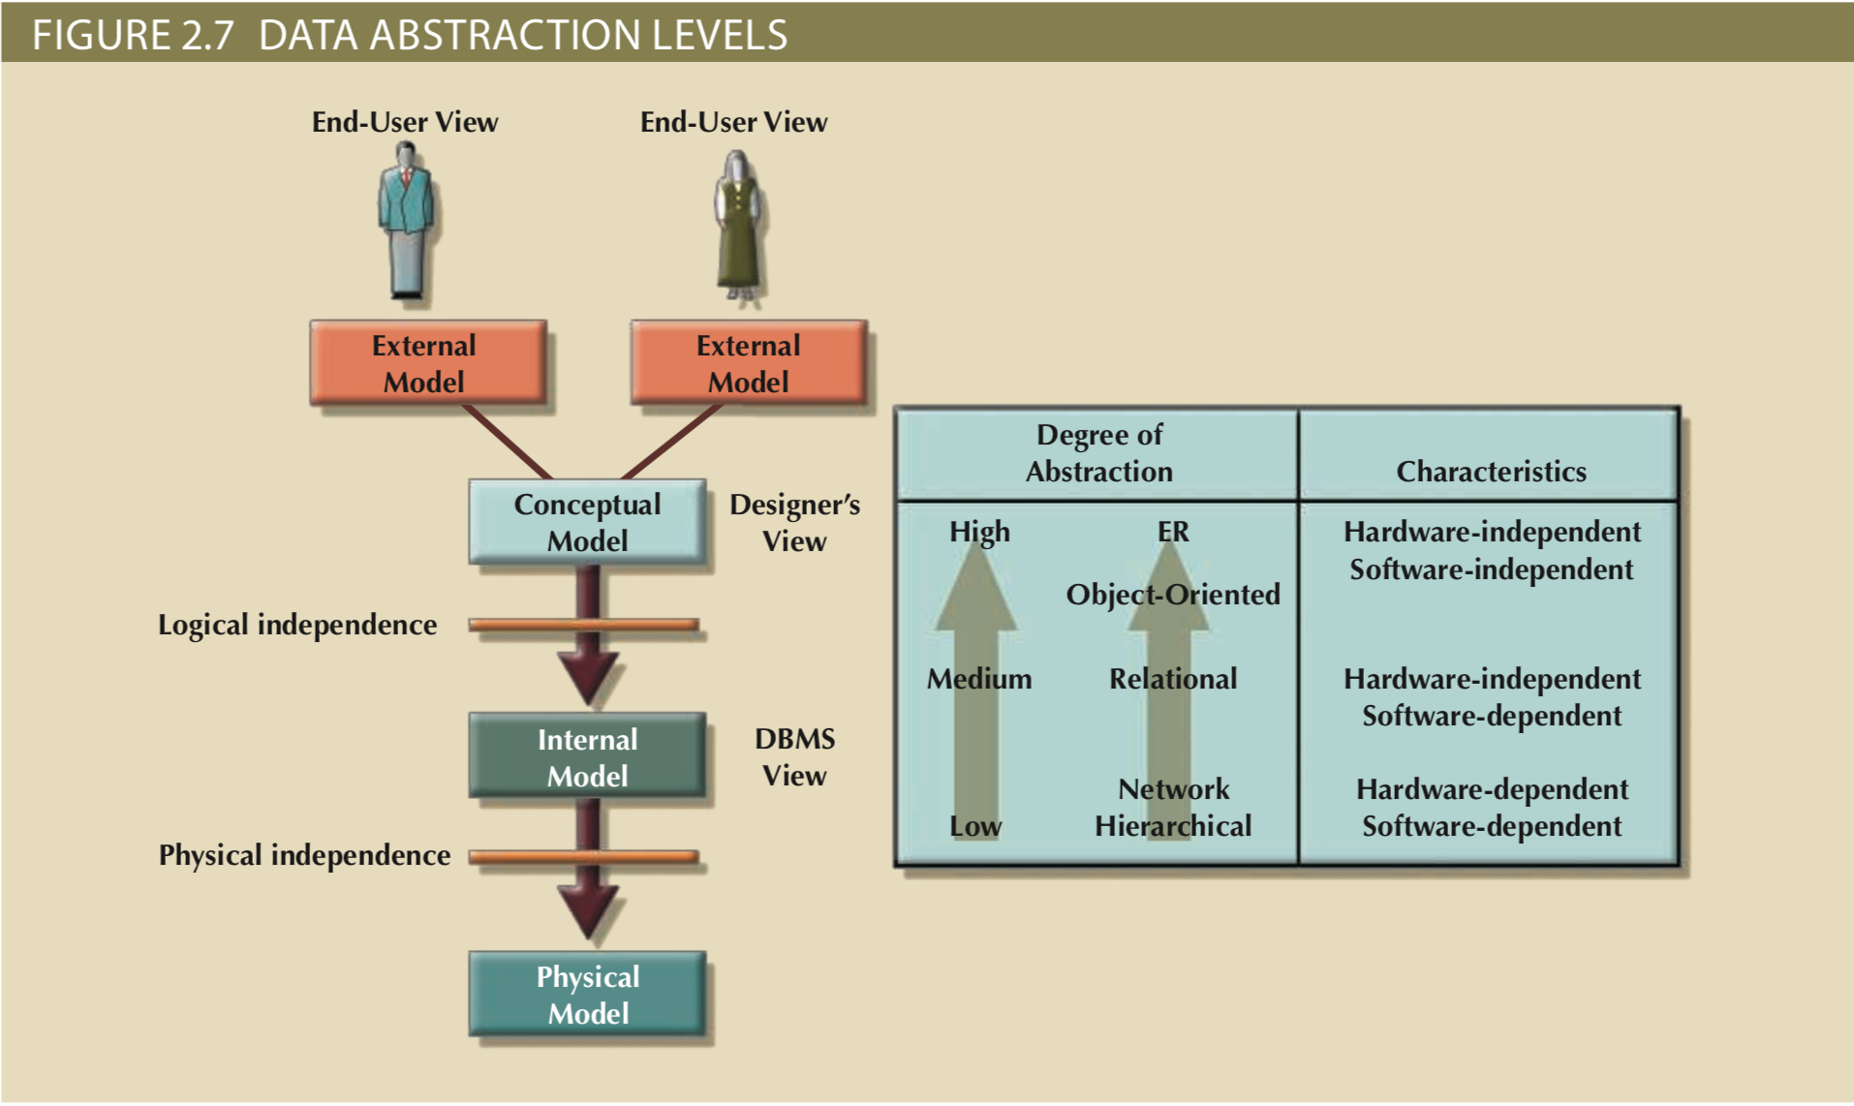
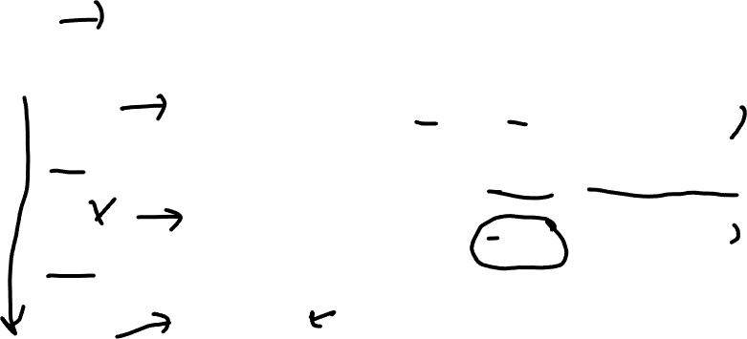

Slide 9

The Entity Relationship Model
Entity relationship diagram (ERD)
Graphical representations model database components
Entity instance or entity occurrence
Rows in a relational table
Connectivity
Describes relationship types
Cardinality
Describes the degree of relationship types

Slide 10
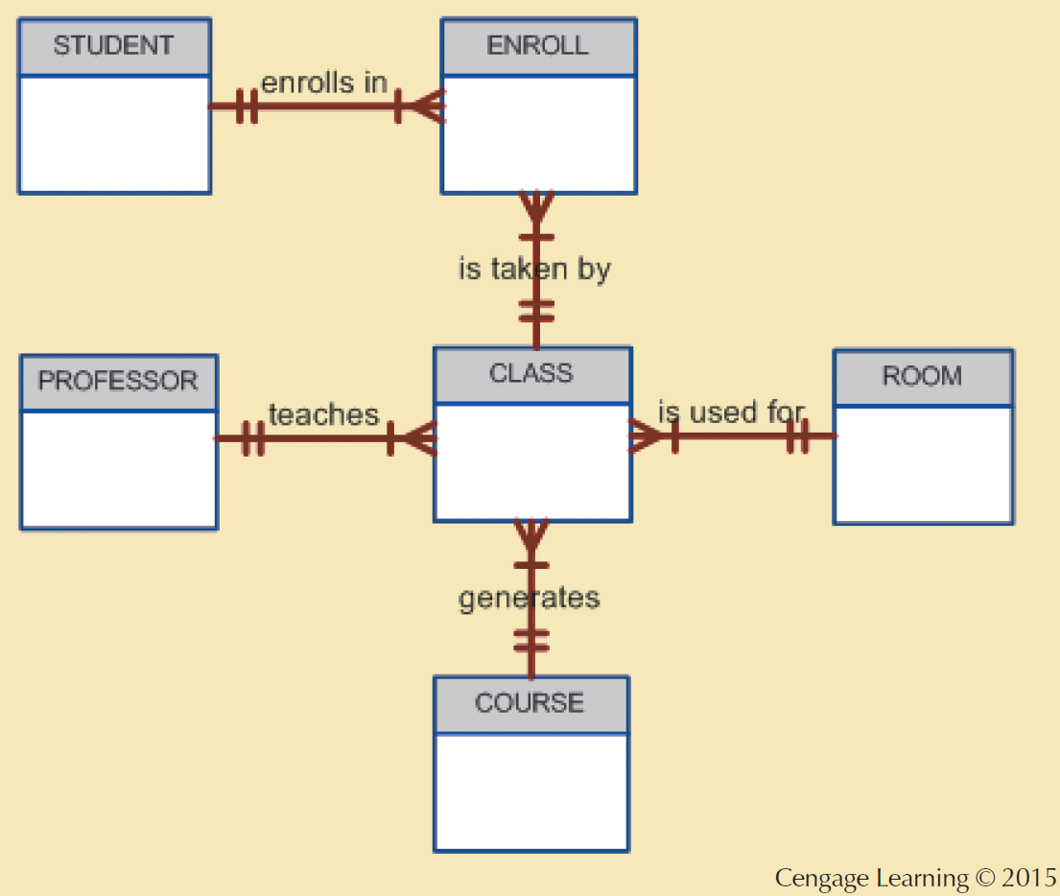


Slide 11
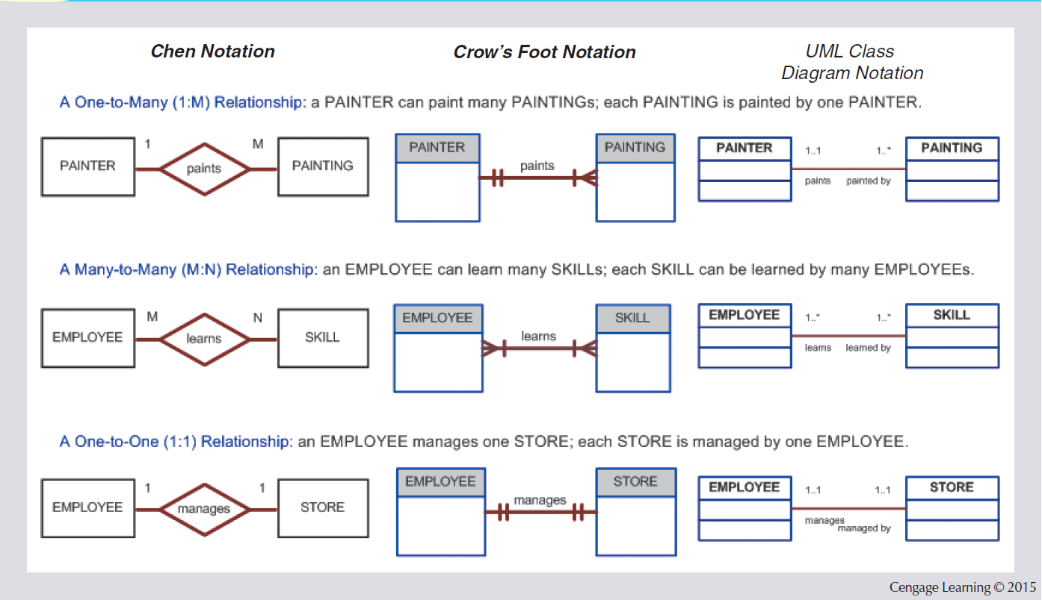
Entity Relationship Model

Slide 12
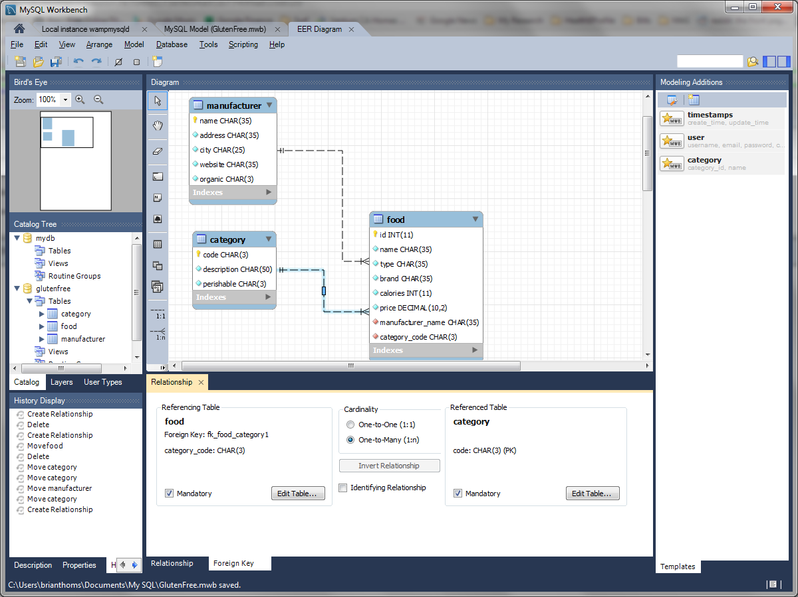
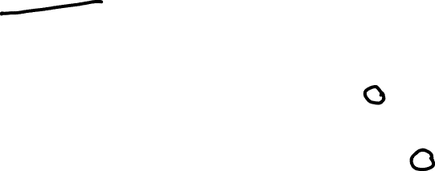
MySQL Workbench Relationships

Slide 13

Entity Relationship Building Blocks
Entities: Distinct objects used to collect and store data.
Comprised of:
Attributes: Characteristics about an entity
Relationships: Related attributes that link two entities.
13

Slide 14
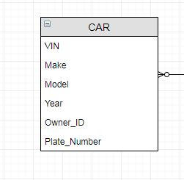

Simple Entity 1 (CAR)
Car Entity
Car Attributes (characteristics)
-
-
-
-
14

Slide 15
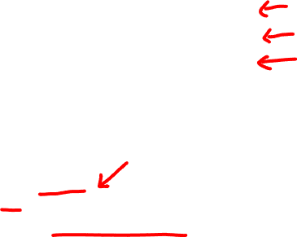
Car Entity as a table
VIN | MAKE | MODEL | YEAR | OWNER_ID
1GYFK36299R035007 | Jaguar | F-TYPE | 2016 | 5TDFHVPCG
WAUCFAFR9EA386228 | BMW | M5 | 2015 | 6HRGFITSJ
YV1960AS2A1981766 | Subaru | Outback | 2015 | 5MZINQEAT
Metadata is the DBA’s responsibility
Name: MAKE
Data Type: varchar
Size: 12
Description: Make will store car’s make

Slide 16
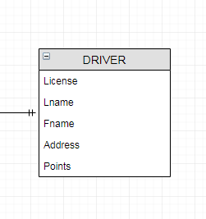
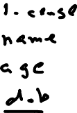
Simple Entity 2 (DRIVER)
Driver Entity
Driver Attributes
-
-
-
-
16

Slide 17
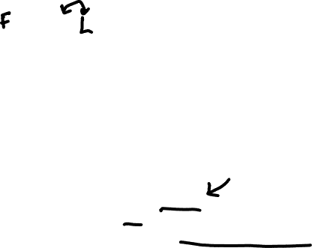
Driver Entity as a table
LICENSE | LNAME | FNAME | ADDRESS | Points
5TDFHVPCG | Michelle | Rodriguez | Texas | 16
6HRGFITSJ | Brian | Thoms | Los Angeles | 0
5MZINQEAT | Joan | Rivers | New York | 2
Name: LNAME
Data Type: varchar
Size: 24
Description: Captures driver’s last name

Slide 18
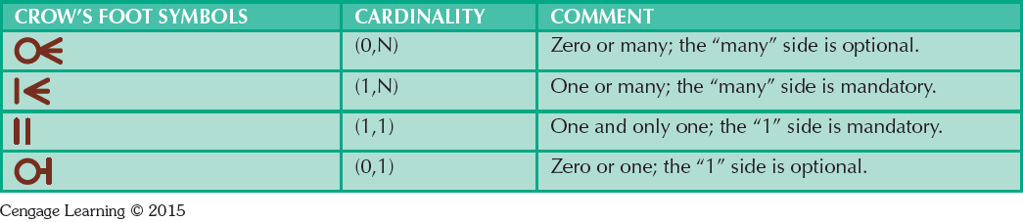
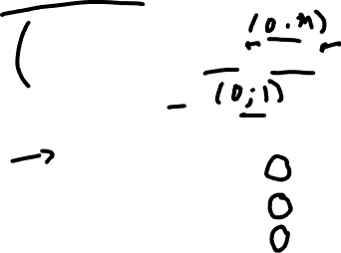
How Entities Relate
Relationship: Describes an association among entities
One-to-many (1:M)
Many-to-many (M:N), M:M also used
One-to-one (1:1)

Slide 19
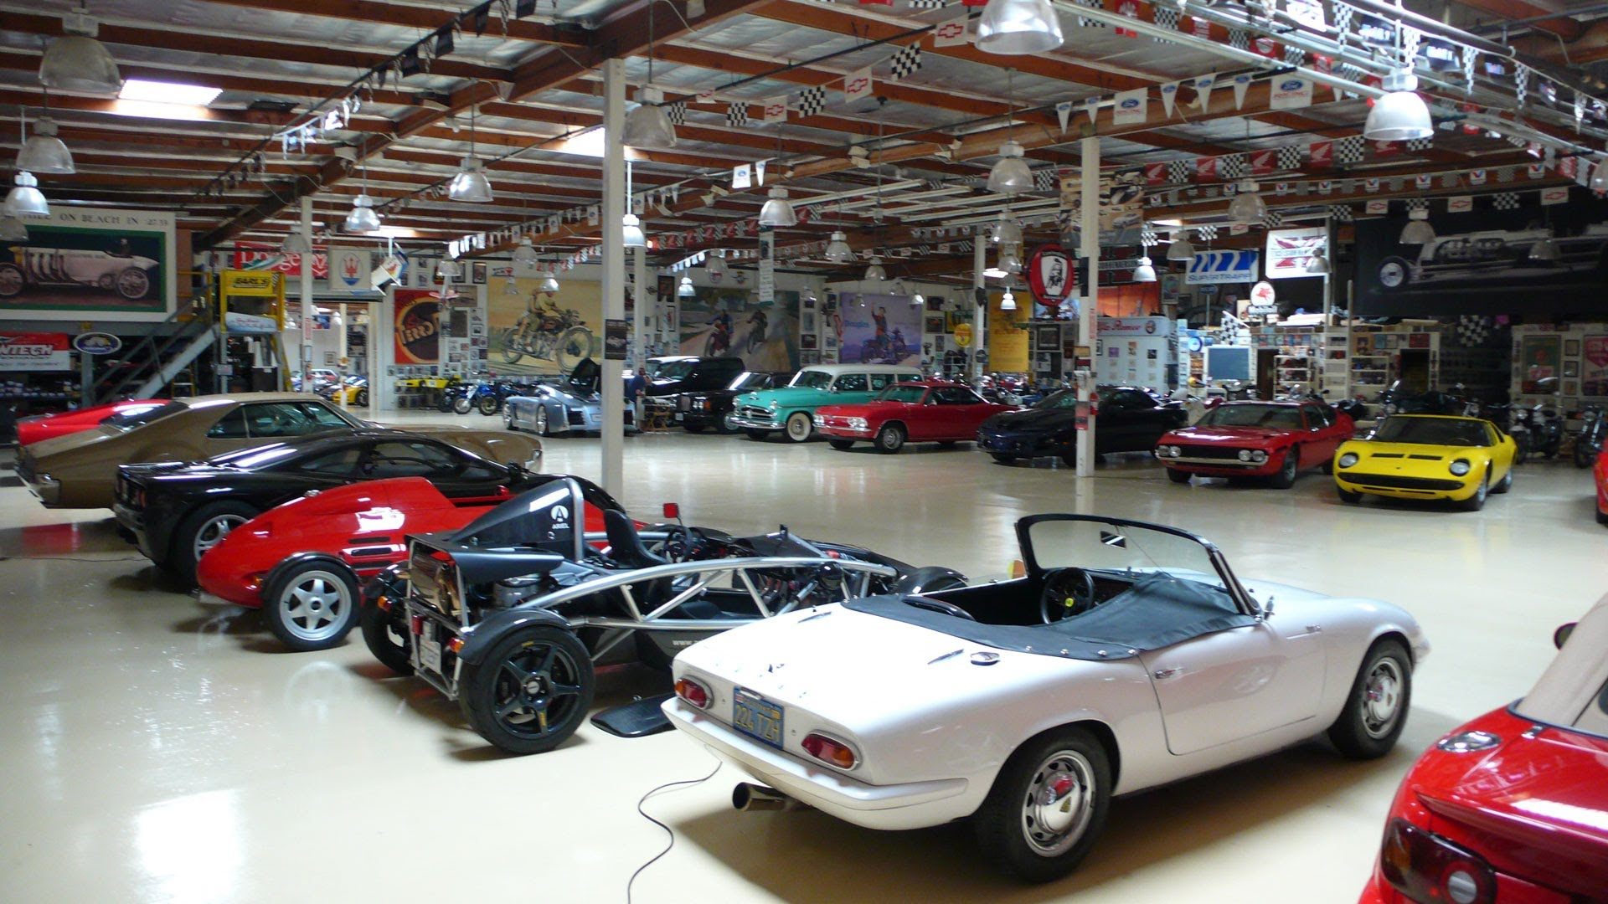
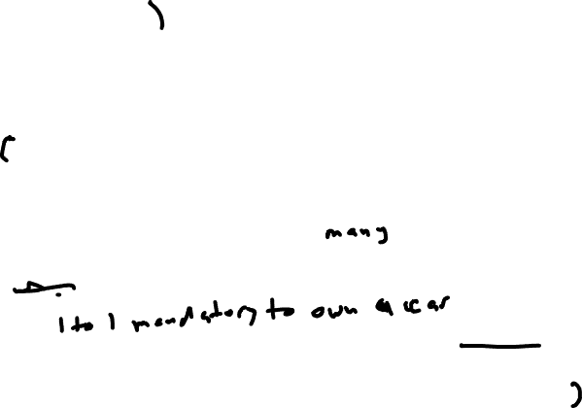
Relationship of Driver to Car?
LICENSE | LNAME | FNAME | ADDRESS
5TDFHVPCG | Jason | Statham | England
6HRGFITSJ | Brian | Thoms | Los Angeles
5MZINQEAT | Sam | Elliot | Texas
How many cars can 1 driver legally own?
0 to many since 1 driver can own zero or many cars
VIN | MAKE | MODEL | YEAR | OWNER_ID
1GYFK36299R035007 | BMW | M3 | 2015 | 5TDFHVPCG
WAUCFAFR9EA386228 | BMW | M5 | 2015 | 6HRGFITSJ
YV1960AS2A1981766 | Subaru | Outback | 2015 | 5MZINQEAT

Slide 20
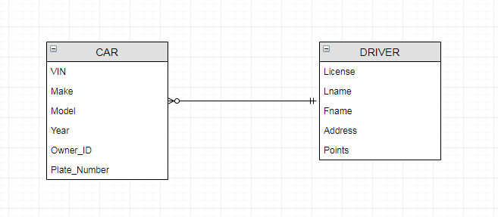
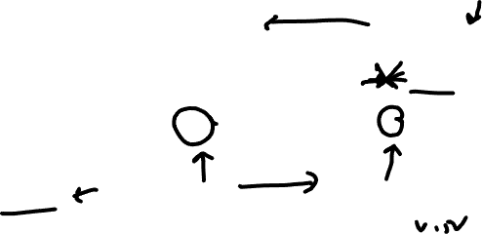
Relationships
Which table, captures information from the other? And why?

Slide 21
Relationships
Which table, captures information from the other? And why?

Slide 22
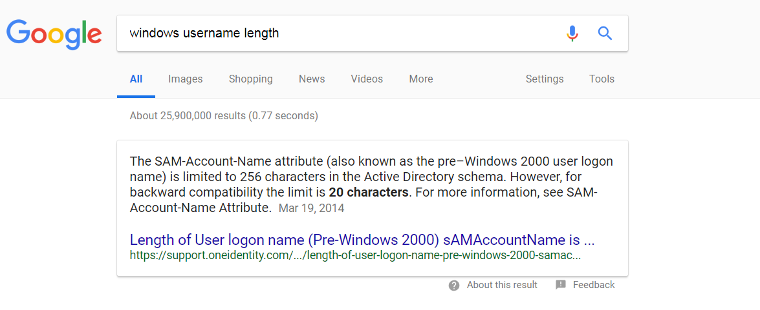

Constraints
Constraint: Set of rules that ensure data integrity (driven by business rules)
VIN > 0 and 17 digits long
Model Year < Current_Year + 1, Odometer > 0
Constraints are often defined by a set of Business Rules

Slide 23
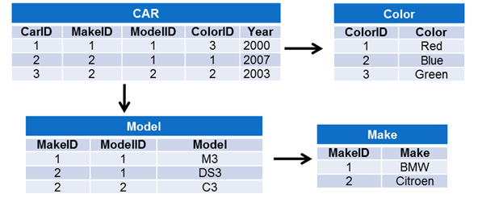
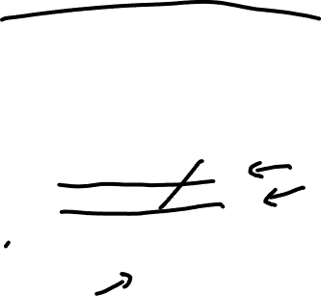
The Relational Database (RDBMS)
Invented by EF Codd circa 1970
Based on a relation (a.k.a. table)
Matrix of intersecting rows and fields
Across are {Tuples, Rows, Records}
Down are {Attribute, Columns, Fields}

Slide 24
Business Rules
Brief, precise, and unambiguous description of a policy, procedure, or principle
Help define the basic building blocks for data
Describe the main and distinguishing characteristics of the data
24

Slide 25
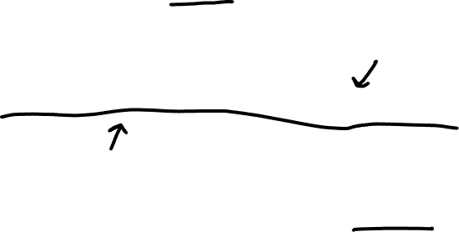
Sources of Business Rules
Company managers
Policy makers
Department managers
Written documentation
Direct interviews with end users
Industry Standards
Speed 65
If I am storing an MD5 hashed password, what should the size of my field be?
MD5, WEP
Examples?

Slide 26

Troubling Ted’s Tiger and Toddler Emporium
Kitties and Kiddies Galore!
26

Slide 27
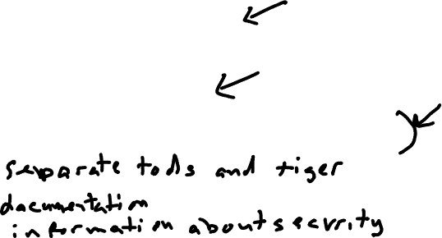
Troubling Ted’s Tiger and Toddler Emporium
Toddler Showroom and Storage
Tiger Showroom and Storage
What are some probably necessary business rules?
1. ???
2. ???
3. ???
4. ???
27

Slide 28

Reasons for Identifying and Documenting Business Rules
Standardize company view of data
Communications tool between users and designers
Allow designers to:
Understand role, scope of data, and business processes
Develop participation rules and constraints
Create accurate data models

Slide 29

Translating Business Rules into ER Model
Nouns translate into entities
Car, driver, student, class, tiger, toddler, etc.
Verbs translate into relationships among entities
Drivers drive cars
Cars must have unique VIN
Students take/register classes, Faculty teach classes
29

Slide 30
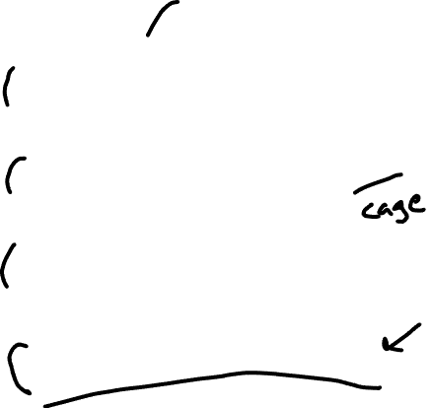
Quiz Slide!
All tigers must have a PAW ID.
Please select all the probable entities mentioned in these business rules.
All toddlers be stored in a toddler pen.
The maximum age for a toddler is 2 years old.
A tiger cage can only house 1 tiger.

Slide 31

Translating Business Rules into ER Model
Relationships are bi-directional.
Questions to identify the relationship type
How many instances of B are related to one instance of A?
How many instances of A are related to one instance of B?
31

Slide 32
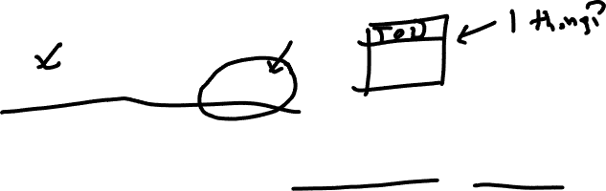
Entities
A concrete or abstract “thing” that can form relationships with other “things”
Entity in ERD is an entity set
Tuples / rows / records are entity occurrences or instances

Slide 33
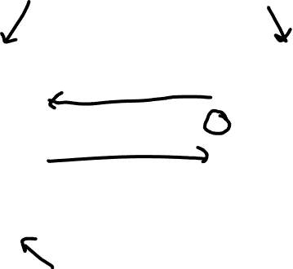
Entities
33

Slide 34
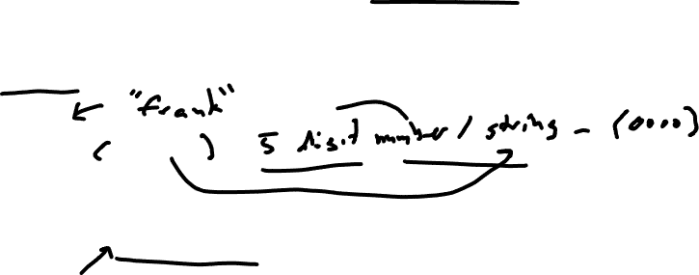
Attributes
Characteristics of entities, which translate into fields during DB implementation
Will have a domain, that is a set of possible values for a given attribute
Balance ??
Zip Code ??
Will usually have an explicit data type (constrains domain)
34

Slide 35

Required Attributes
Must have a value, cannot be left empty (i.e. cannot be NULL)
Does a CSUCI student need to have a Dolphin ID?
Does a CSUCI student need to have a middle name?
35

Slide 36

Optional Attributes
Does not require a value, can be left empty (i.e. can be NULL)
Does a CSUCI student need to have a middle name?
Does a CSUCI student need a home phone number?
36

Slide 37
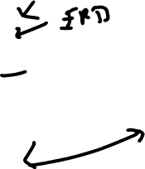
37

Slide 38
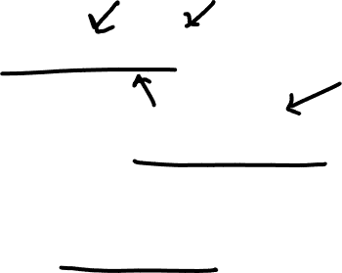
Identifiers
Implemented as a Primary Key (PK) in relational model
Referenced PKs are known as Foreign Keys (FK) when used in relationships
Appear prominently in relational schema, shorthand for table structure

Slide 39

Relational Schema
TABLE NAME (KEY ATTRIBUTE 1, ATTRIBUTE 2, …ATTRIBUTE K)
CAR (CAR_VIN, MODEL_CODE, CAR_YEAR, CAR_COLOR)
DRIVER (DRIVER_LISC, DRIVER_FNAME, DRIVER_LNAME, POINTS)
“Key Attribute” is a primary key and an identifier attribute

Slide 40
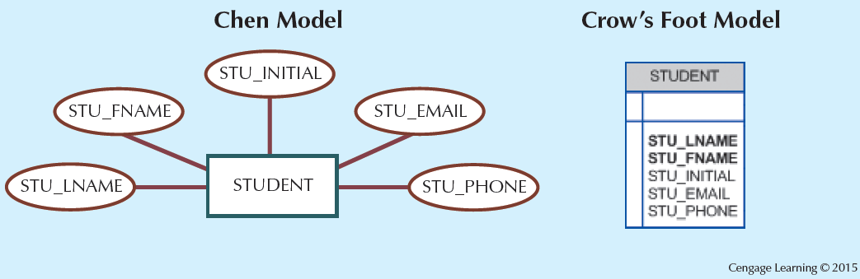

Naming Conventions
STU_ID
40

Slide 41

Further Attribute types
Composite identifier (composite key): Primary key composed of more than one attribute
Composite attribute: Attribute that can be subdivided to yield additional attributes
- Name, Address, Phone, DOB
Simple attribute: Attribute that cannot be subdivided
- Age (in years, etc.)

Slide 42
Even More Attribute Types (Whew..)
Composite identifier (composite key): Primary key composed of more than one attribute
Composite attribute: Attribute that can be subdivided to yield additional attributes
Name, Address, Phone, DOB
CAR (CAR_VIN, MODEL_CODE, CAR_YEAR, CAR_COLOR)
Simple attribute: Attribute that cannot be subdivided
- Age

Slide 43

Even More Attribute Types (Whew..)
Composite identifier (composite key): Primary key composed of more than one attribute
Composite attribute: Attribute that can be subdivided to yield additional attributes
Name, Address, Phone, DOB
CAR (CAR_VIN, MODEL_CODE, CAR_YEAR, CAR_COLOR)
Simple attribute: Attribute that cannot be subdivided
- Age

Slide 44
Quiz!
Identify the simple attributes in the following relational schemas.
CAR (CAR_VIN, MODEL_CODE, CAR_YEAR, CAR_COLOR)
TIGER (TIGER_ID, TIGER_FULL_NAME, TIGER_FIRST_NAME, TIGER_WEIGHT, TIGER_ORIGIN_ADDRESS)

Slide 45
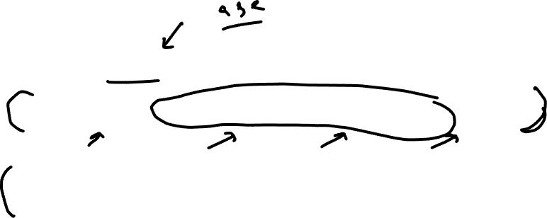
Quiz!
Identify the simple attributes in the following relational schemas.
CAR (CAR_VIN, MODEL_CODE, CAR_YEAR, CAR_COLOR)
TIGER (TIGER_ID, TIGER_FULL_NAME, TIGER_FIRST_NAME, TIGER_WEIGHT, TIGER_ORIGIN_ADDRESS)

Slide 46

Multivalued Attributes
Table name: STUDENT
stu_id | first_name | last_name | hobbies
1639 | George | Barnes | reading
5629 | Susan | Noble | hiking, movies
3388 | Erwin | Star | hockey, skiing
5772 | Alice | Buck | NULL
1911 | Frank | Borders | photography, travel, art
4848 | Hanna | Diedrich | gourmet cooking
How to query students who like traveling?
46

Slide 47
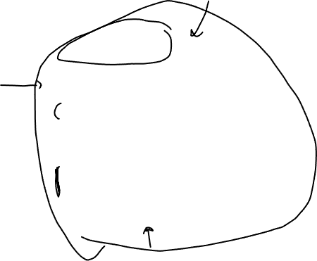
Multivalued Attributes (Cont’d)
How are these tables linked?
What is the connectivity of this relationship?
Table name: HOBBY
stu_id | hobby
1639 | reading
5629 | hiking
5629 | movies
3388 | hockey
3388 | skiing
1911 | photography
1911 | travel
1911 | art
4848 | gourmet cooking
Table name: STUDENT
stu_id | first_name | last_name
1639 | George | Barnes
5629 | Susan | Noble
3388 | Erwin | Star
5772 | Alice | Buck
1911 | Frank | Borders
4848 | Hanna | Diedrich
47

Slide 48

Relationships
Association between entities always operate in both directions
Participants: Entities that participate in a relationship
Connectivity: Describes the relationship classification
Cardinality: Expresses the minimum and maximum number of entity occurrences associated with one occurrence of related entity
48

Slide 49
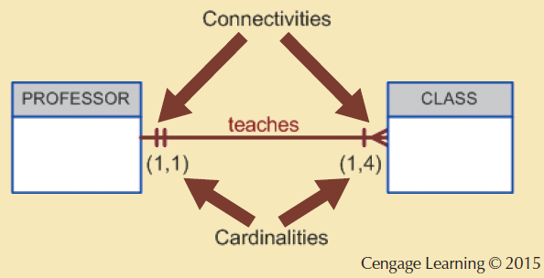
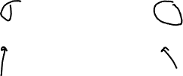
Connectivity and Cardinality
Identify 1 or 2 business rules.
49

Slide 50
Cardinality
?
Table name: HOBBY
stu_id | hobby
1639 | reading
5629 | hiking
5629 | movies
3388 | hockey
3388 | skiing
1911 | photography
1911 | travel
1911 | art
4848 | gourmet cooking
Table name: STUDENT
stu_id | first_name | last_name
1639 | George | Barnes
5629 | Susan | Noble
3388 | Erwin | Star
5772 | Alice | Buck
1911 | Frank | Borders
4848 | Hanna | Diedrich
50

Slide 51
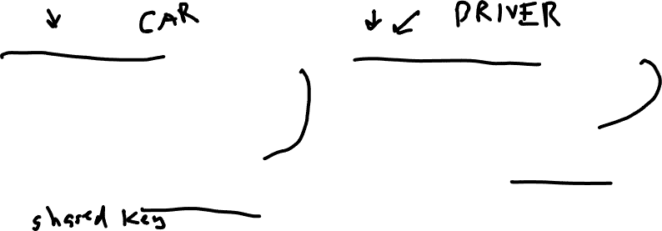
Entity Dependence and Independence
Existence dependence
Existence independence
Entity exists in the database only when it is associated with another related entity occurrence
Referred to as a weak entity
Has a strong (identifying) relationship with another entity.
Entity exists apart from all of its related entities
Referred to as a strong entity or regular entity
Has a weak (non-identifying) relationship with another entity.
51

Slide 52
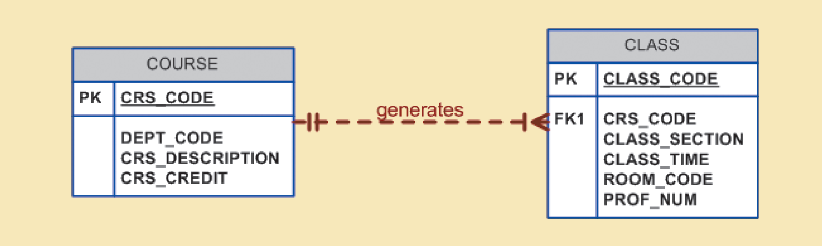
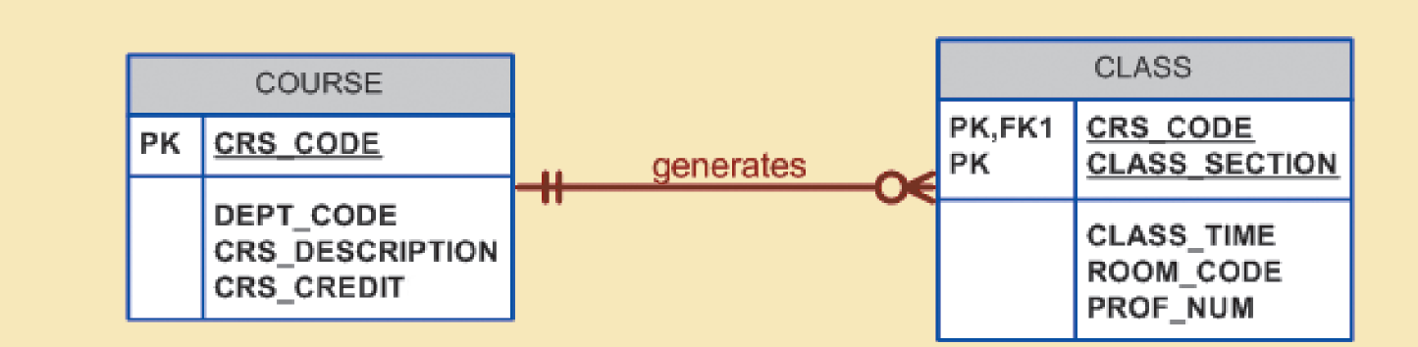
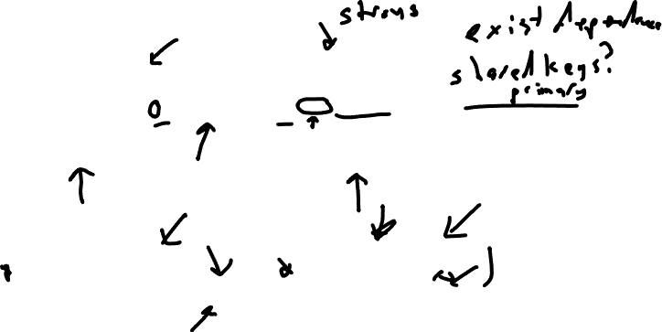
Strong Entity vs. Weak Entity
52

Slide 53
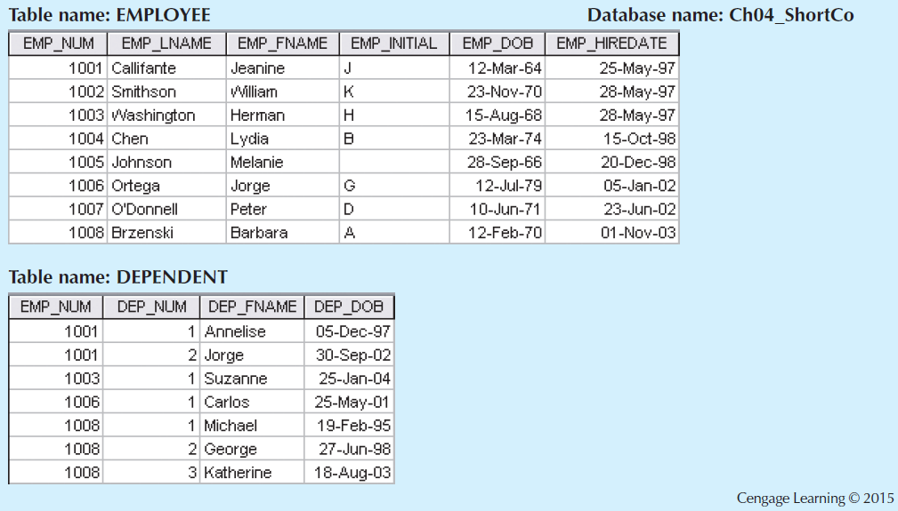

A Weak Entity in a Strong Relationship
53

Slide 54
Relationship Participation
Optional participation
One entity occurrence does not require a corresponding entity occurrence in a particular relationship
Mandatory participation
One entity occurrence requires a corresponding entity occurrence in a particular relationship

Slide 55
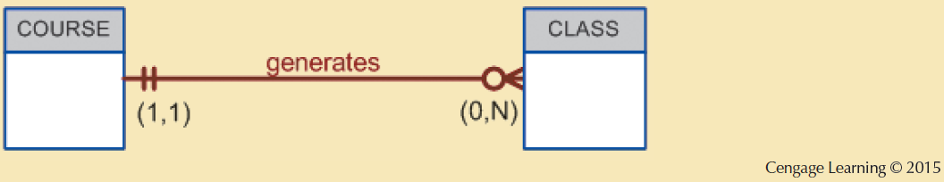
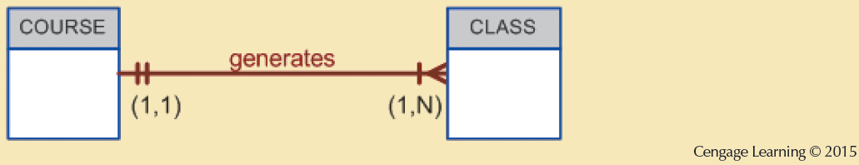

Optional vs. Mandatory
These are very different relationships
55

Slide 56
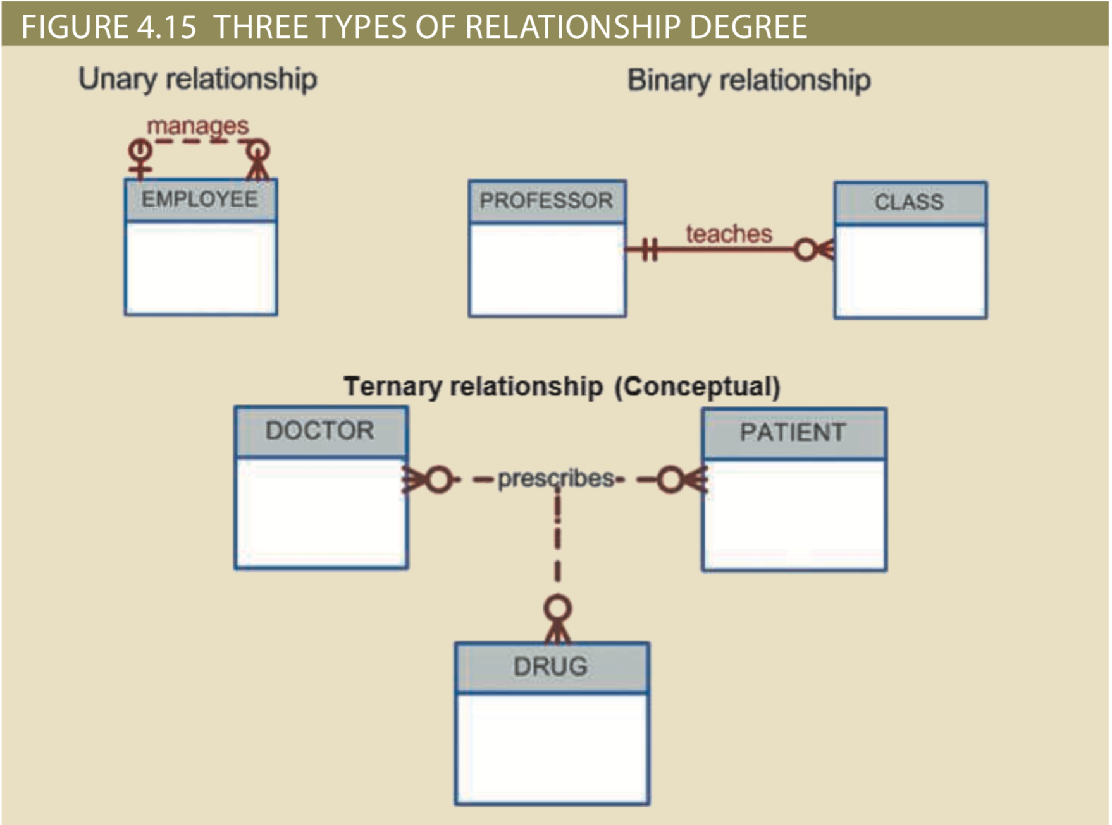

Relationship Degree

Slide 57

Associative Entities
Also known as composite or bridge entities
Used to represent an M:N relationship between two or more entities
Is in a 1:M relationship with the parent entities
Composed of the primary key attributes of each parent entity
May also contain additional attributes that play no role in connective process
57

Slide 58
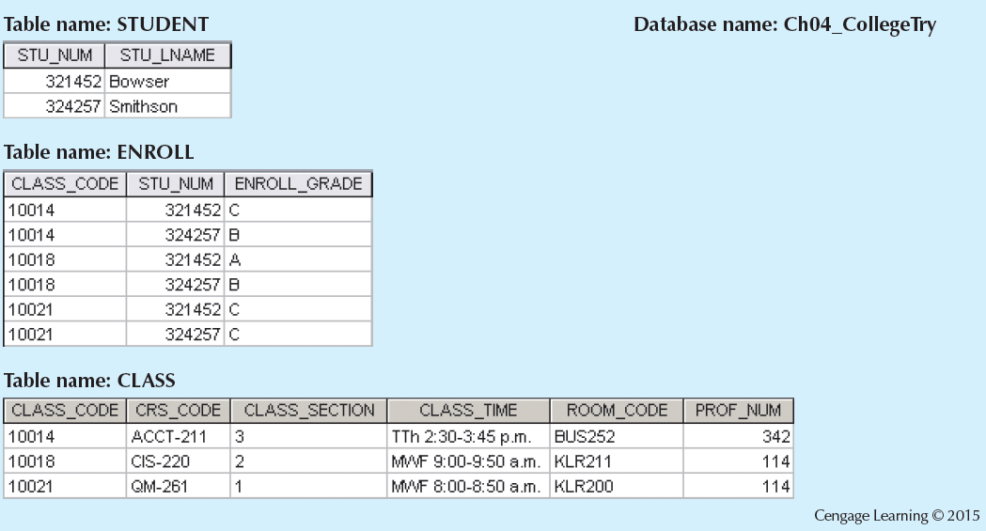

Converting the M:N Relationship into Two 1:M Relationships
58

Slide 60
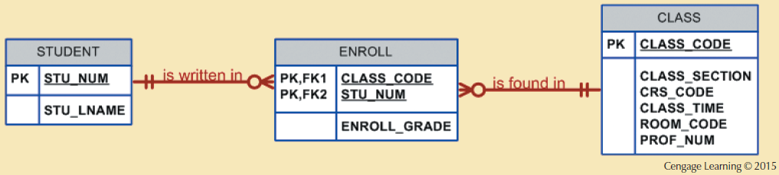

A Composite Entity in an ERD
Enrollment is a composition of a single student and a single class section.
60

Slide 61

Quiz!
The relationship between STUDENT and ENROLL is:
Mandatory
Optional
Zero-to-many
Weak
Operational
61

Slide 62
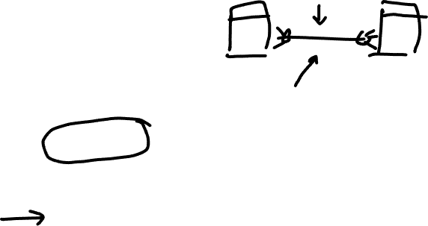

Slide 63
A Note on Naming Conventions
Entity names:
Descriptive (TIGER, TODDLER, etc.)
Terminology familiar to the users
Attribute names:
Descriptive of the data represented by the attribute (TIGER_NAME, TIGER_AGE, etc.)
Proper naming conventions:
Facilitates communication between parties (TIGER not PANTHERA_TIGRIS)
Promotes self-documentation

Slide 64
Developing an ER Diagram
Create a detailed narrative of the organization’s description of operations
Identify business rules based on the descriptions
Identify main entities and connections (i.e. relationships) from the business rules
Develop the initial ERD
Identify the attributes and primary keys that adequately describe entities
Revise and review ERD

Slide 65
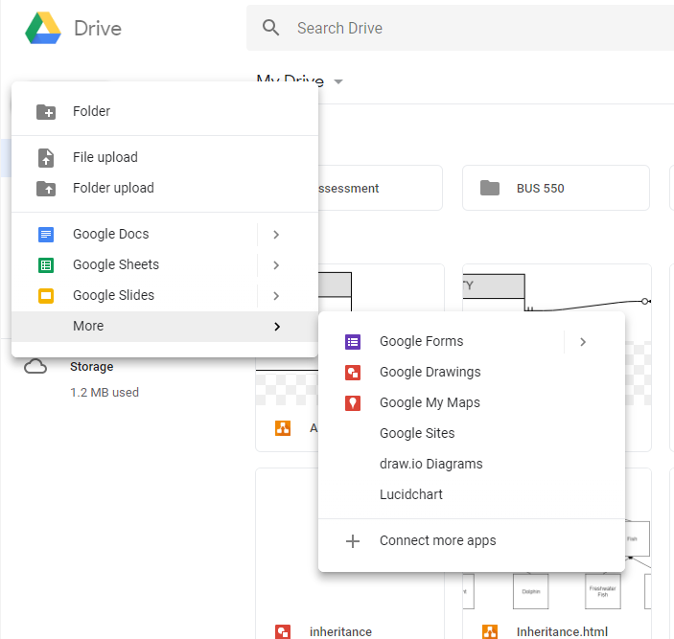
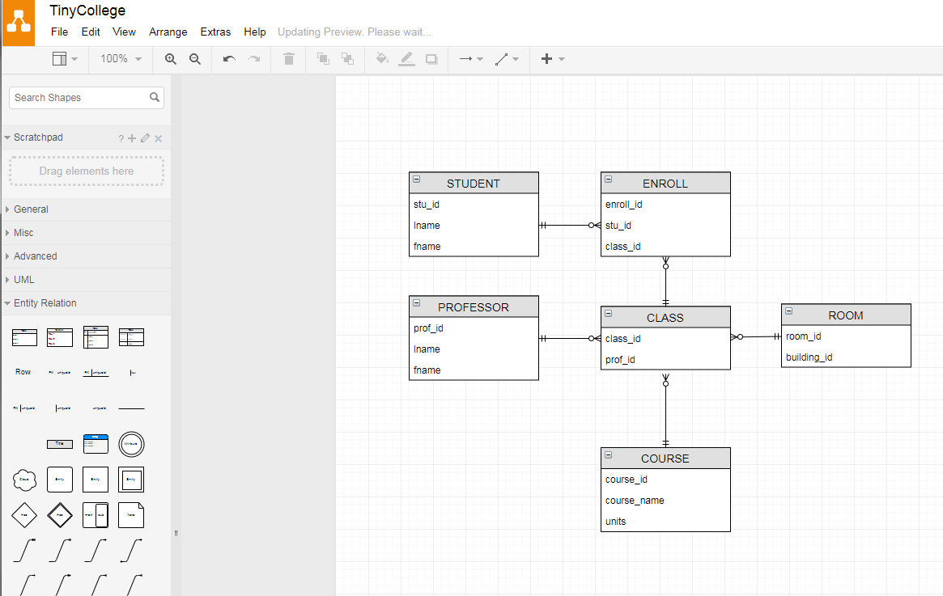
Draw.io (in Google Docs)
65

Slide 66
Draw.io Tips
“Entity Relation”
Ctrl + Enter (Cmd + Enter on Mac) to add a row to an entity table
Draw connections and then change endings and paths

Slide 67
In-Class Exercise
In group ERD diagram
Someone is a Draw.io captain
Create an ERD based on the following description and business rules
Submit it through Canvas, will discuss on Wednesday
67

Slide 68


Channel Island Artists (CIA)
This database needs to track artworks, artists, and the galleries displaying artists’ artworks.
Each artwork has a title and a medium.
Each artist has a first and last name.
Each gallery has a name and an address.
A gallery can display many artworks.
An artwork has only one artist.
An artist can have many artworks.
68

